Slide 2
Read construction
Unique ind. barcode
Sequence of interest
Illumina adapter
Restriction site

Slide 3
Read construction
Unique ind. barcode
Sequence of interest
Illumina adapter
Restriction site

Slide 4
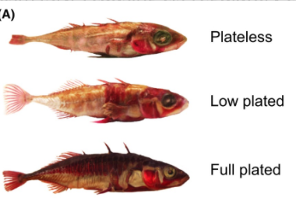
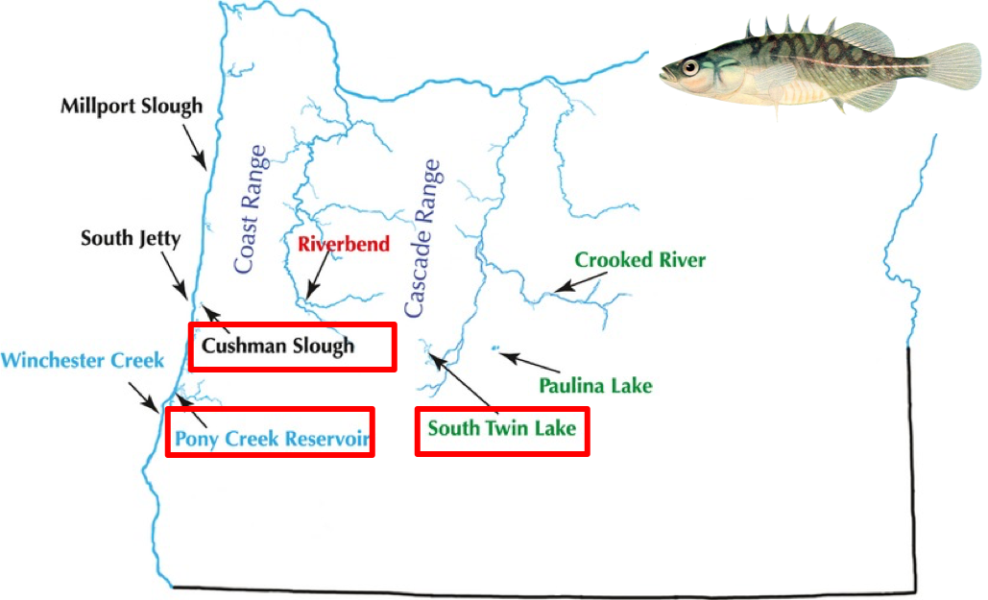
Mazzarella et al. 2016
Catchen et al 2013

Slide 5
Denovo pipeline
USTACKS
Build loci de novo
Pipel
ine
CSTACKS
Assemble catalog
SSTACKS
Match to catalog
Populations
Filter loci and compute
Population statistics

Slide 7
Parameter Description | denovo_map.pl Parameter | Pipeline component | Component Parameter | Default Value
Minimum stack depth / minimum depth of coverage | -m | ustacks | -m | 3
Distance allowed between stacks | -M | ustacks | -M | 2
Distance allowed between catalog loci | -n | cstacks | -n | 1

Slide 8
reference pipeline
USTACKS
Build loci de novo
Pipel
ine
CSTACKS
Assemble catalog
SSTACKS
Match to catalog
Populations
Filter loci and compute
Population statistics

Slide 9
Reference pipeline
Pipel
ine
Alignment to a reference genome
Populations
Filter loci and compute
Population statistics

